Slide 1
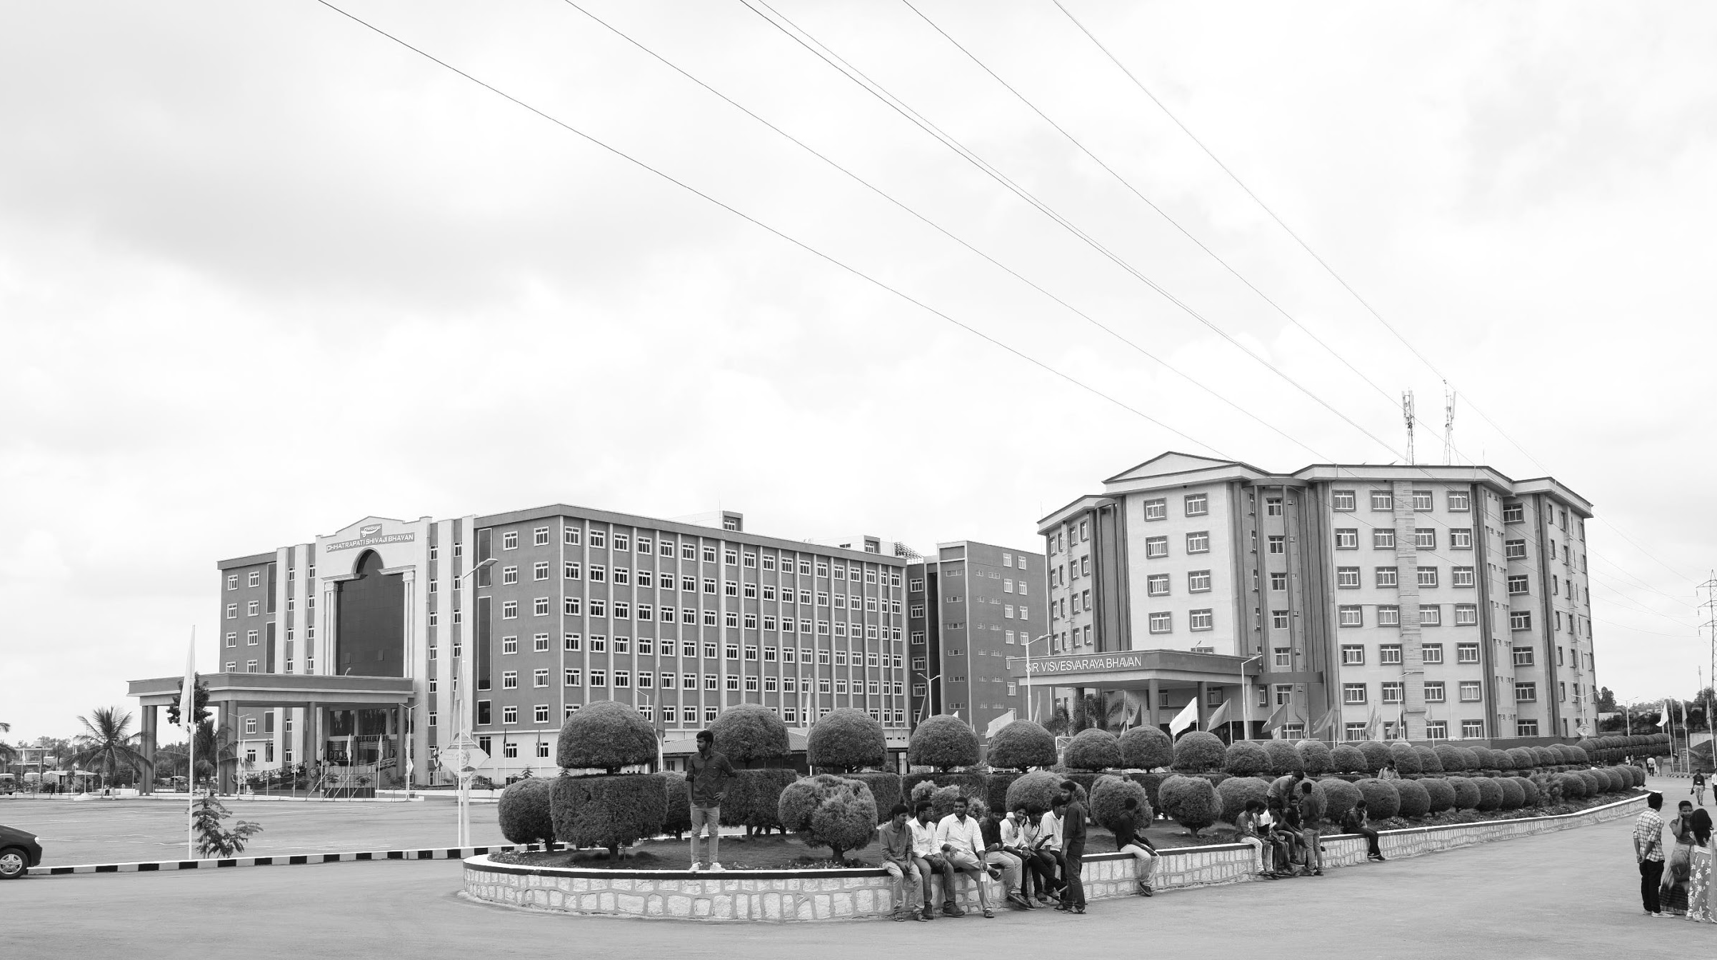

ZYNQ-Disease Detect: Precision Agriculture Solutions and Comparative Studies with AI Technologies
Mid-Review 1/2/3
Major Project
Project ID: PROJ3999
AY 2021-25
GITAM (Deemed-to-be) University
Department of Electrical Electronics and Communication Engineering
Project Team:
BU21EECE0100100 (S.Sameera Tasneem)
BU21EECE0100103 (S.Sai Lohitha)
BU21EECE0100360 (R.Indumathi)
Project Mentor:
Dr. M. Arun Kumar
Associate Professor
Project In-charge:
Dr. M. Arun Kumar
www.gitam.edu

Slide 2
Objective and Goals
Objective
To use ZYNQ 7000 SoC to process plant leaf images and videos, focusing on edge detection and real-time analysis.
To develop external AI models to classify plant diseases based on processed data.
To ensure real-time performance and robustness under varying agricultural conditions.
To compare ZYNQ’s image processing performance with other platforms.
Goals
Real-Time Disease Detection:
Achieve accurate and timely detection of plant diseases to facilitate prompt intervention.
Scalable Agricultural Solution:
Develop a cost-effective and scalable system suitable for deployment in diverse agricultural environments.
Expand detection to other agricultural diagnostics like pests or nutrient deficiencies.
Validate the system through field tests for practical usability and refinement.
Develop a user-friendly interface to assist farmers in decision-making.

Slide 3
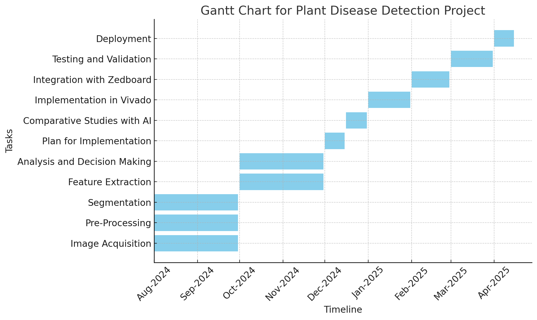
Project Plan (Clearly mention milestone for objectives under each reviews)
Gant Chart - Milestones and Activities
Resources : https://www.officetimeline.com/gantt-chart/how-to-make/excel & https://www.teamgantt.com/
Phase-2
Review 1
Phase-1
Figure: Gantt Chart for FPGA-Based Plant Disease Detection System Development

Slide 4
Milestones
Literature Survey & Objective Finalization
Completed literature review and finalized project objectives.
MATLAB Implementation
Implemented Canny and Sobel edge detection.
Used Otsu’s method and K-means clustering for separating healthy and diseased plant parts.
Vivado Setup for ZYNQ 7000 SoC
Transition to Vivado for hardware integration with ZYNQ 7000 SoC.
Interface image/video processing with the SoC.
Real-Time Processing on ZYNQ 7000
Implement image processing techniques on ZYNQ 7000 SoC for real-time disease detection.
AI Model Development
Develop and integrate AI models (e.g., CNNs) for plant disease classification.
System Testing & Validation
Test and validate the system in real-world agricultural settings.
Comparative Study
Compare AI-based methods with traditional image processing techniques.
Optimization & Scalability
Optimize system performance and explore scalability for larger fields.
Documentation & Future Work
Document findings and plan future enhancements for the system.

Slide 5
Literature Survey (Improved post minor project)
Key Publications
Google scholar research best 3-5 papers
V. K. Perumal, T. Supriyaa, S. P. R., and S. Dhanasekaran, "CNN based plant disease identification using PYNQ FPGA," in Systems and Soft Computing, vol. 6, p. 200088, 2024. doi: https://doi.org/10.1016/j.sasc.2024.200088.
B. Sasmal, A. Das, K. G. Dhal, S. B. Saheb, R. A. Khurma, and P. A. Castillo, "A novel groundnut leaf dataset for detection and classification of groundnut leaf diseases," in Data in Brief, vol. 55, p. 110763, 2024. doi: https://doi.org/10.1016/j.dib.2024.110763.
J. Ahmed, S. A. A. Zaidi, S. Aziz, A. Rashid, and S. Haider, "Real time vision-based implementation of plant disease identification system on FPGA," in Mehran University Research Journal of Engineering and Technology, vol. 42, no. 2, pp. 19-29, 2023. doi: 10.22581/muet1982.2302.03.
Key Resources – Whitepaper| Application Notes | Datasheet| Others
CNN-based Plant Disease Identification using PYNQ FPGA
Key Resources:
Whitepapers:
Implementation of Convolutional Neural Networks (CNN) on FPGA platforms.
Overview of the PYNQ FPGA ecosystem for AI applications.
Application Notes:
Deploying TensorFlow or PyTorch models on PYNQ FPGA.
PYNQ-Z2 board application note for AI/ML applications.

Slide 6
Datasheets:
Technical datasheet for PYNQ-Z2 board detailing hardware specs.
FPGA acceleration datasheet for CNN-based inference.
Other Resources:
Python and Jupyter Notebook examples for plant disease datasets.
Open-source repositories for CNN-based plant disease detection.
A Novel Groundnut Leaf Dataset for Detection and Classification of Groundnut Leaf Diseases
Key Resources:
Datasets:
Groundnut leaf image dataset, including labeled images for classification.
Augmentation tools or scripts used to preprocess the dataset.
Whitepapers:
Creating robust datasets for agricultural disease detection.
Statistical methods to ensure dataset diversity and quality.
Others:
Metadata on dataset: resolution, size, categories, etc.
Documentation on dataset collection methodology.
Real-Time Vision-Based Implementation of Plant Disease Identification System on FPGA
Key Resources:
Whitepapers:
Real-time systems for agricultural applications using FPGA.
Vision-based disease detection techniques for plants.
Application Notes:
FPGA-based image processing pipeline for real-time inference.
Guidelines for implementing Sobel/Canny edge detection on FPGA.

Slide 7
Datasheets:
Details on the specific FPGA board (e.g., Zynq 7000 SoC).
Other Resources:
Edge AI frameworks (e.g., Vitis AI, Xilinx tools).
Case studies on agricultural IoT systems integrated with FPGA
Existing Implementations – Products| Opensource| GitHub etc
Products:
Plantix App: AI-powered plant disease detection and remedies. Visit: www.plantix.net
Leaf Doctor: Tool for analyzing leaf damage in crops.
Open-Source Tools:
PlantVillage Dataset: Comprehensive dataset of diseased and healthy plant leaves. Access: www.plantvillage.org
OpenCV: Library for image preprocessing and edge detection. Visit: opencv.org
TensorFlow/PyTorch: Frameworks for CNN model training and deployment.
TensorFlow: www.tensorflow.org
PyTorch: pytorch.org
GitHub Repositories:
PYNQ-ML: Deploying ML models on PYNQ FPGA. Repo: www.github.com/Xilinx/PYNQ-ML
CNN for Plant Disease: Implementation using PlantVillage dataset. Repo: www.github.com/spMohanty/PlantVillage-Dataset
FPGA Image Processing: Real-time classification projects on FPGA. Repo: www.github.com/Xilinx/Embedded-Design-Tutorials

Slide 8
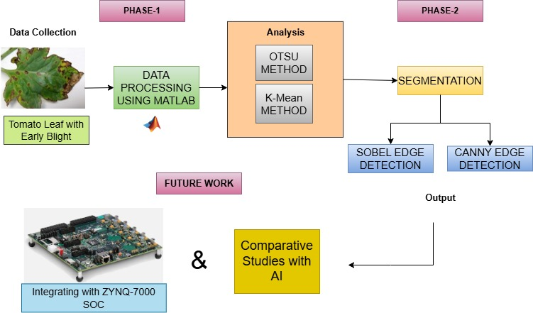
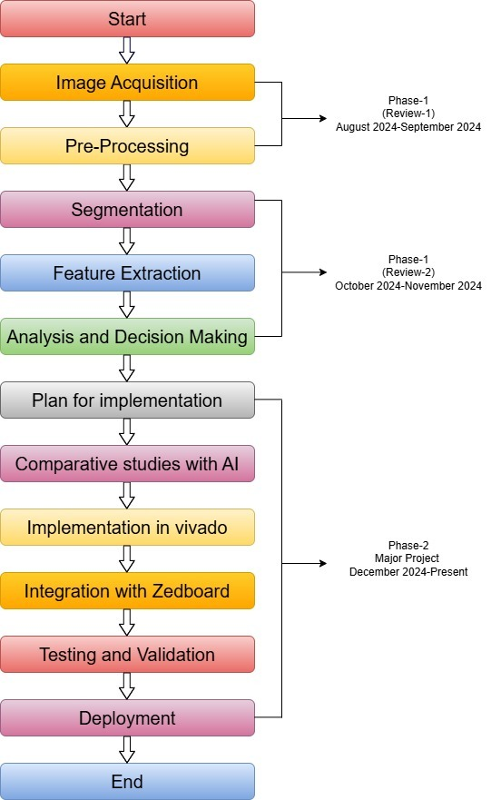
Architecture
Structural Diagram
Block Diagram/Pin Diagram
Fig a. Circuit Implementation of the proposed system
Behaviour Diagram
Flow chart/ State machine
Fig b. WorkPlan of the proposed system

Slide 9
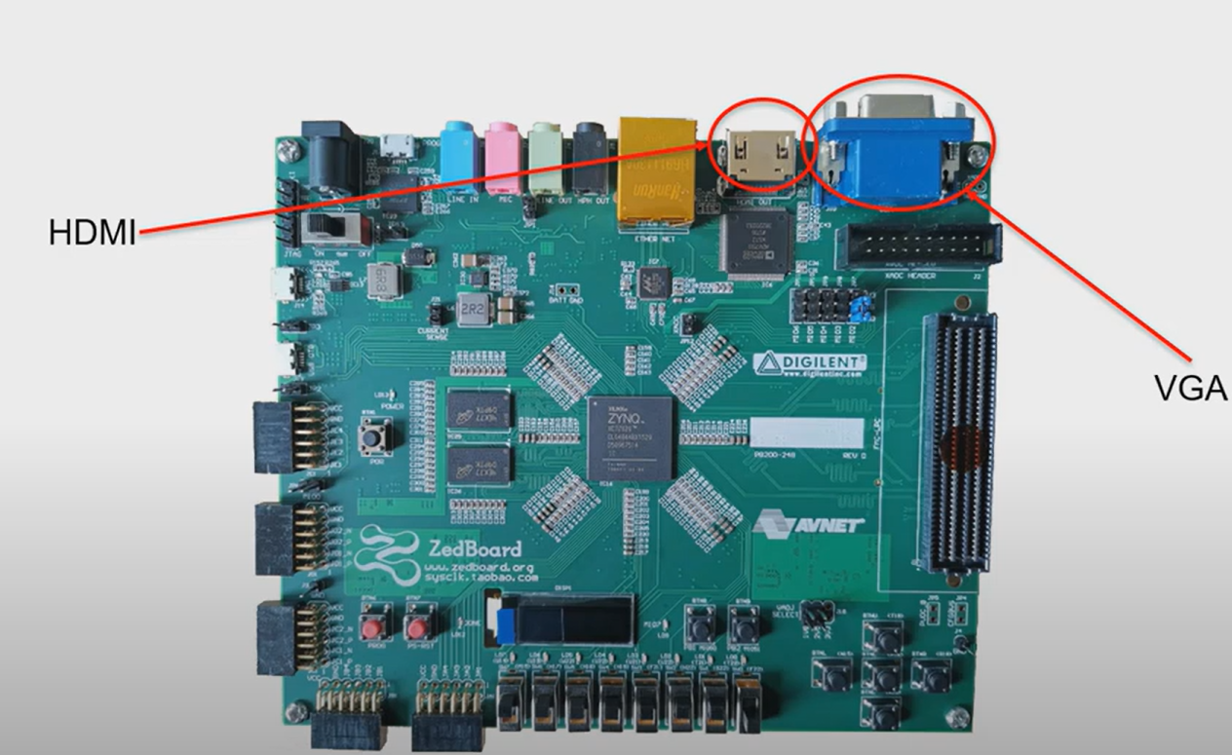
ZedBoard vs Nexys 4: Performance and Display Interface Overview
ZedBoard has an ARM Cortex-A9 processor that handles complex tasks like edge detection, while Nexys 4 relies only on hardware, making it less flexible.
The ZedBoard combines software and FPGA for efficient processing, whereas Nexys 4 is limited to hardware-only implementations, making development harder.
ZedBoard supports tools like Linux and OpenCV, making video and image processing faster and easier compared to Nexys 4.
ZedBoard’s architecture handles high-resolution images and real-time video better, while Nexys 4 may struggle with resource-intensive tasks.
ZedBoard Display Interfaces:
VGA Controller:
A VGA (Video Graphics Array) Controller is a component that generates the necessary timing and signals to interface with a VGA display.
It creates synchronization signals (horizontal sync and vertical sync) and manages the pixel data for rendering images on a VGA monitor.
HDMI:
HDMI (High-Definition Multimedia Interface) is a digital connection used to transmit high-quality video and audio signals between devices, like TVs, monitors, and laptops.
Fig-ZYNQ 7000 SOC Board

Slide 10
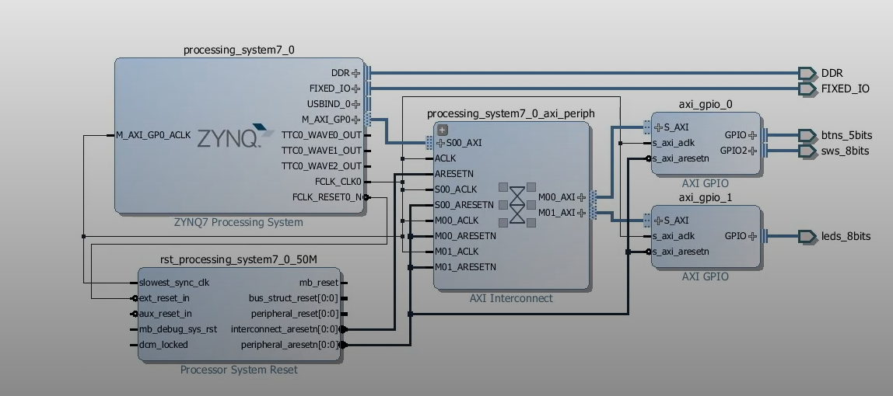
Review 1: Steps to Design and Implement a Zynq-Based VGA Controller in Vivado
The process of creating a block diagram for a Zynq-based VGA Controller starts with visualizing the key components of the system and their interactions.
Create Vivado Project: Start a new RTL Project and select the FPGA part.
Add Zynq Processing System IP: Use Zynq PS for processing, configure clocks, reset, and peripherals.
Add VGA Controller IP: Add VGA sync and pixel generator IPs (or custom logic for VGA signals).
Configure Clock and Reset: Add Clocking Wizard for VGA pixel clock and Reset Generator for initialization.
Create Block Design: Drag and connect Zynq PS, clock, reset, and VGA signals (e.g., vid_hsync ,vid_vsync).
Define Address Map (If Needed): Map peripherals to specific addresses using AXI interface.
Connect I/O Ports: Assign pins for VGA signal(Dout,vid_hsync,vid_vsync) in the I/O Planning view.
Generate Bitstream: Synthesize and generate the bitstream for FPGA.
Simulate (Optional): Simulate design and verify output signals.
Export Design: Export the HDL wrapper and generate the bitstream for hardware implementation.
Fig:Block Diagram of ZYNQ before doing HDL
Wrapper

Slide 11
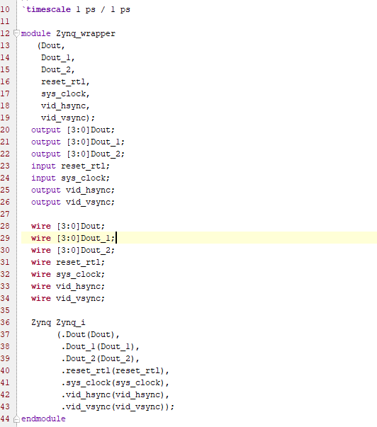
Analysis of the Code
Inputs:
reset_rtl: The reset signal to initialize the system.
sys_clock: The system clock that drives the VGA controller.
Outputs:
Dout, Dout_1, Dout_2: Data outputs (4-bit) that likely represent color or pixel data for the display.
vid_hsync, vid_vsync:Horizontal and vertical synchronization signals for the VGA display.
Module Instantiation:
The Zynq module is instantiated within this wrapper, which takes the inputs(reset_rtl, sys_clock) and drives the outputs(Dout, Dout_1, Dout_2, vid_hsync, vid_vsync).
Fig-Code Generated for the ZYNQ Wrapper Block Diagram

Slide 12
Use Cases & Testing
Use Cases
Generate Pixel Data (Datagen):
Generates pixel data for display using inputs sys_clock and reset_rtl, producing outputs Dout, Dout_1 and Dout_2.
Success is defined by generating correct pixel data based on coordinates.
Generate Sync Signals (Synchronization):
Creates horizontal and vertical sync signals(vid_hsync, vid_vsync) for the VGA display using sys_clock and reset_rtl.
Success ensures correct timing and synchronization for the display.
Multiplex Pixel Data:
Selects and routes appropriate pixel data for display based on control signals, producing outputs Dout, Dout_1, and Dout_2.
Success ensures correct pixel data is routed to the output.
Test Cases
Validate Pixel Data Generation
Objective: Ensure correct pixel data from Dout, Dout_1 and Dout_2.
Steps: Apply sys_clock and reset_rtl, and monitor outputs.
Expected Result: The pixel data corresponds to the expected color pattern.
Validate Sync Signal Generation:
Objective: Verify that vid_hsync and vid_vsync signals are generated correctly.
Steps: Apply sys_clock and reset_rtl, and check the sync signals against the VGA timing specifications.
Expected Result: Horizontal and vertical sync signals follow proper VGA timing.
Test Data Multiplexing:
Objective: Ensure that the multiplexer(mux.v) selects and routes the correct data.
Steps: Apply control signals to select Dout, Dout_1 or Dout_2,and verify the output.
Expected Result: The selected data is correctly routed to the VGA output.
Verify Reset Functionality:
Objective: Ensure that the system resets as expected.
Steps: Apply the reset_rtl signal and verify that the outputs are inactive or reset.
Expected Result: All outputs reset to their initial states.

Slide 13
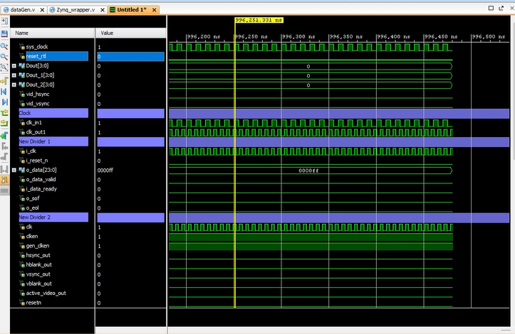
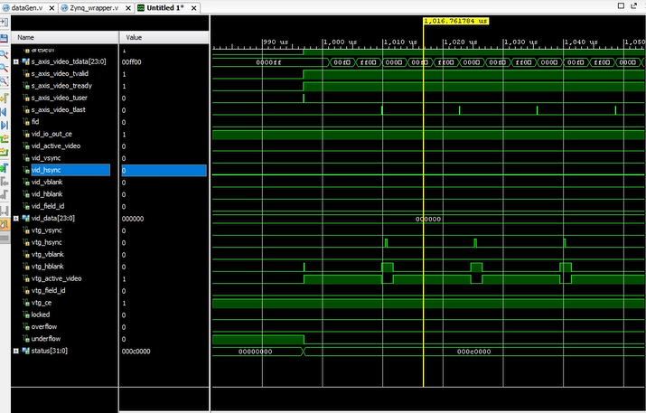
Implementation and Results – Iteration 1
Iteration 1 : Results
Fig-1:RTL Schematic Diagram of ZYNQ for force value 0
Fig-2: RTL Schematic Diagram of ZYNQ for force value 1

Slide 14
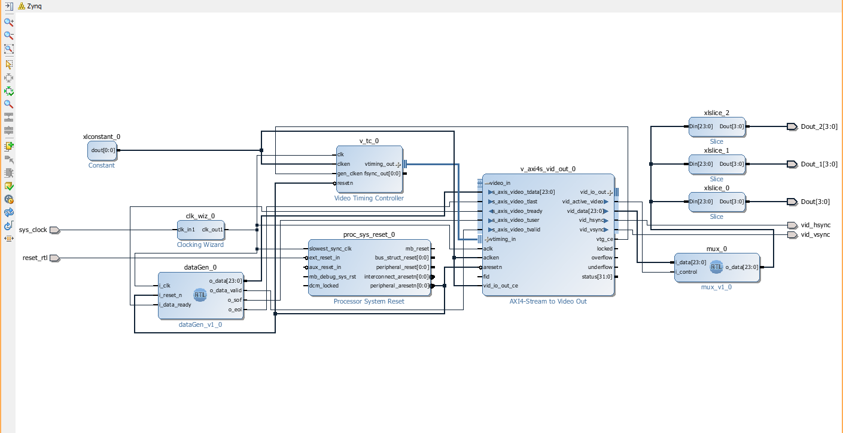
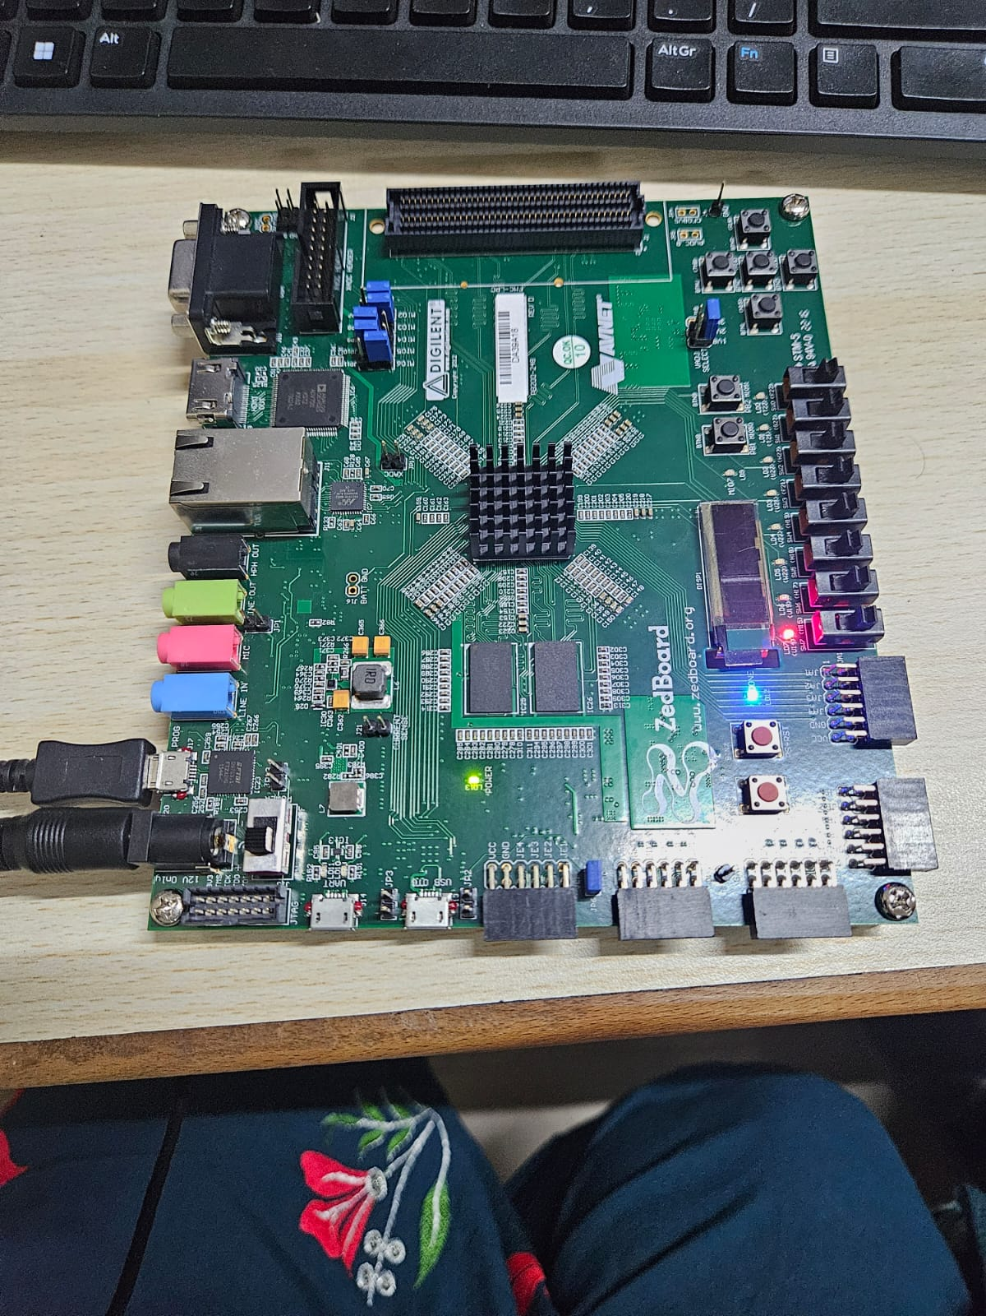
Fig-3:Block Diagram of ZYNQ Wrapper
Fig-4:Interfacing with ZYNQ 7000 SOC

Slide 15
Zynq-Based VGA Controller – Progress Summary(Review 1)
Work Completed & Results
Vivado Project Created: RTL project set up with correct FPGA part.
Zynq PS Integrated: Configured clocks, reset, and peripherals.
VGA Controller Added: Implemented sync and pixel generation.
Clock & Reset Configured: Verified stability via simulation.
Block Design Completed: Connected Zynq PS, clock, reset, and VGA signals.
Address Mapping & I/O Ports: Assigned VGA signal pins, mapped peripherals.
Bitstream Generated: No critical errors, successfully implemented.
Simulation Performed: VGA signal validated, pending further tests.
Design Exported: Ready for hardware deployment.
Conclusion
A functional VGA controller was designed using Zynq PS and FPGA fabric. The system's clocking, synchronization, and initial signal generation were validated. Further optimization and testing will enhance functionality.

Slide 16
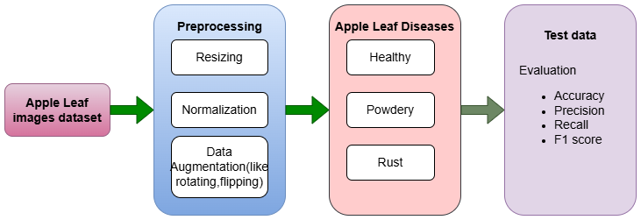
Review 2: Real-Time Automated Plant Disease Classification Using Deep Learning
Problem: Detecting plant diseases early is crucial for crop health but requires expert knowledge and time-consuming manual inspection.
Objective: This project aims to automate plant disease detection using deep learning, classifying leaf images as Healthy, Powdery, or Rust.
Approach: A Convolutional Neural Network (CNN) is trained using augmented image data to improve accuracy and generalization.
Technology: The project uses Keras and TensorFlow for model training and image processing.
Impact: The system offers a scalable, efficient solution for early disease detection, supporting better crop management.
Technologies Used:
Keras:
Keras is a user-friendly, high-level API for building and training deep learning models. It simplifies the process of defining and training neural networks.
Keras is designed to be simple and easy to use, making it ideal for beginners and quick prototyping.
TensorFlow:
TensorFlow is an open-source framework developed by Google for machine learning and deep learning tasks.
It supports both training and inference for models.
Fig-5: System Architecture Block Diagram

Slide 17
Running the Plant Disease Detection System on Google Colab
1.Dataset Preparation:
The images are categorized into three classes:
Healthy: Plants without any disease.
Powdery: Plants affected by Powdery Mildew.
Rust: Plants affected by Rust disease.
These categorized images are used for training, validation, and testing the CNN model.
2.Model Training:
The model is built using TensorFlow and Keras libraries.
Various convolutional layers and pooling layers are applied to extract features from the images.
The CNN model learns to classify images into one of the three categories: Healthy, Powdery, or Rust.
3.Prediction:
After training, the model can predict the disease type for new plant leaf images.
This allows for real-time plant disease detection, assisting in faster decision-making in agriculture.

Slide 18
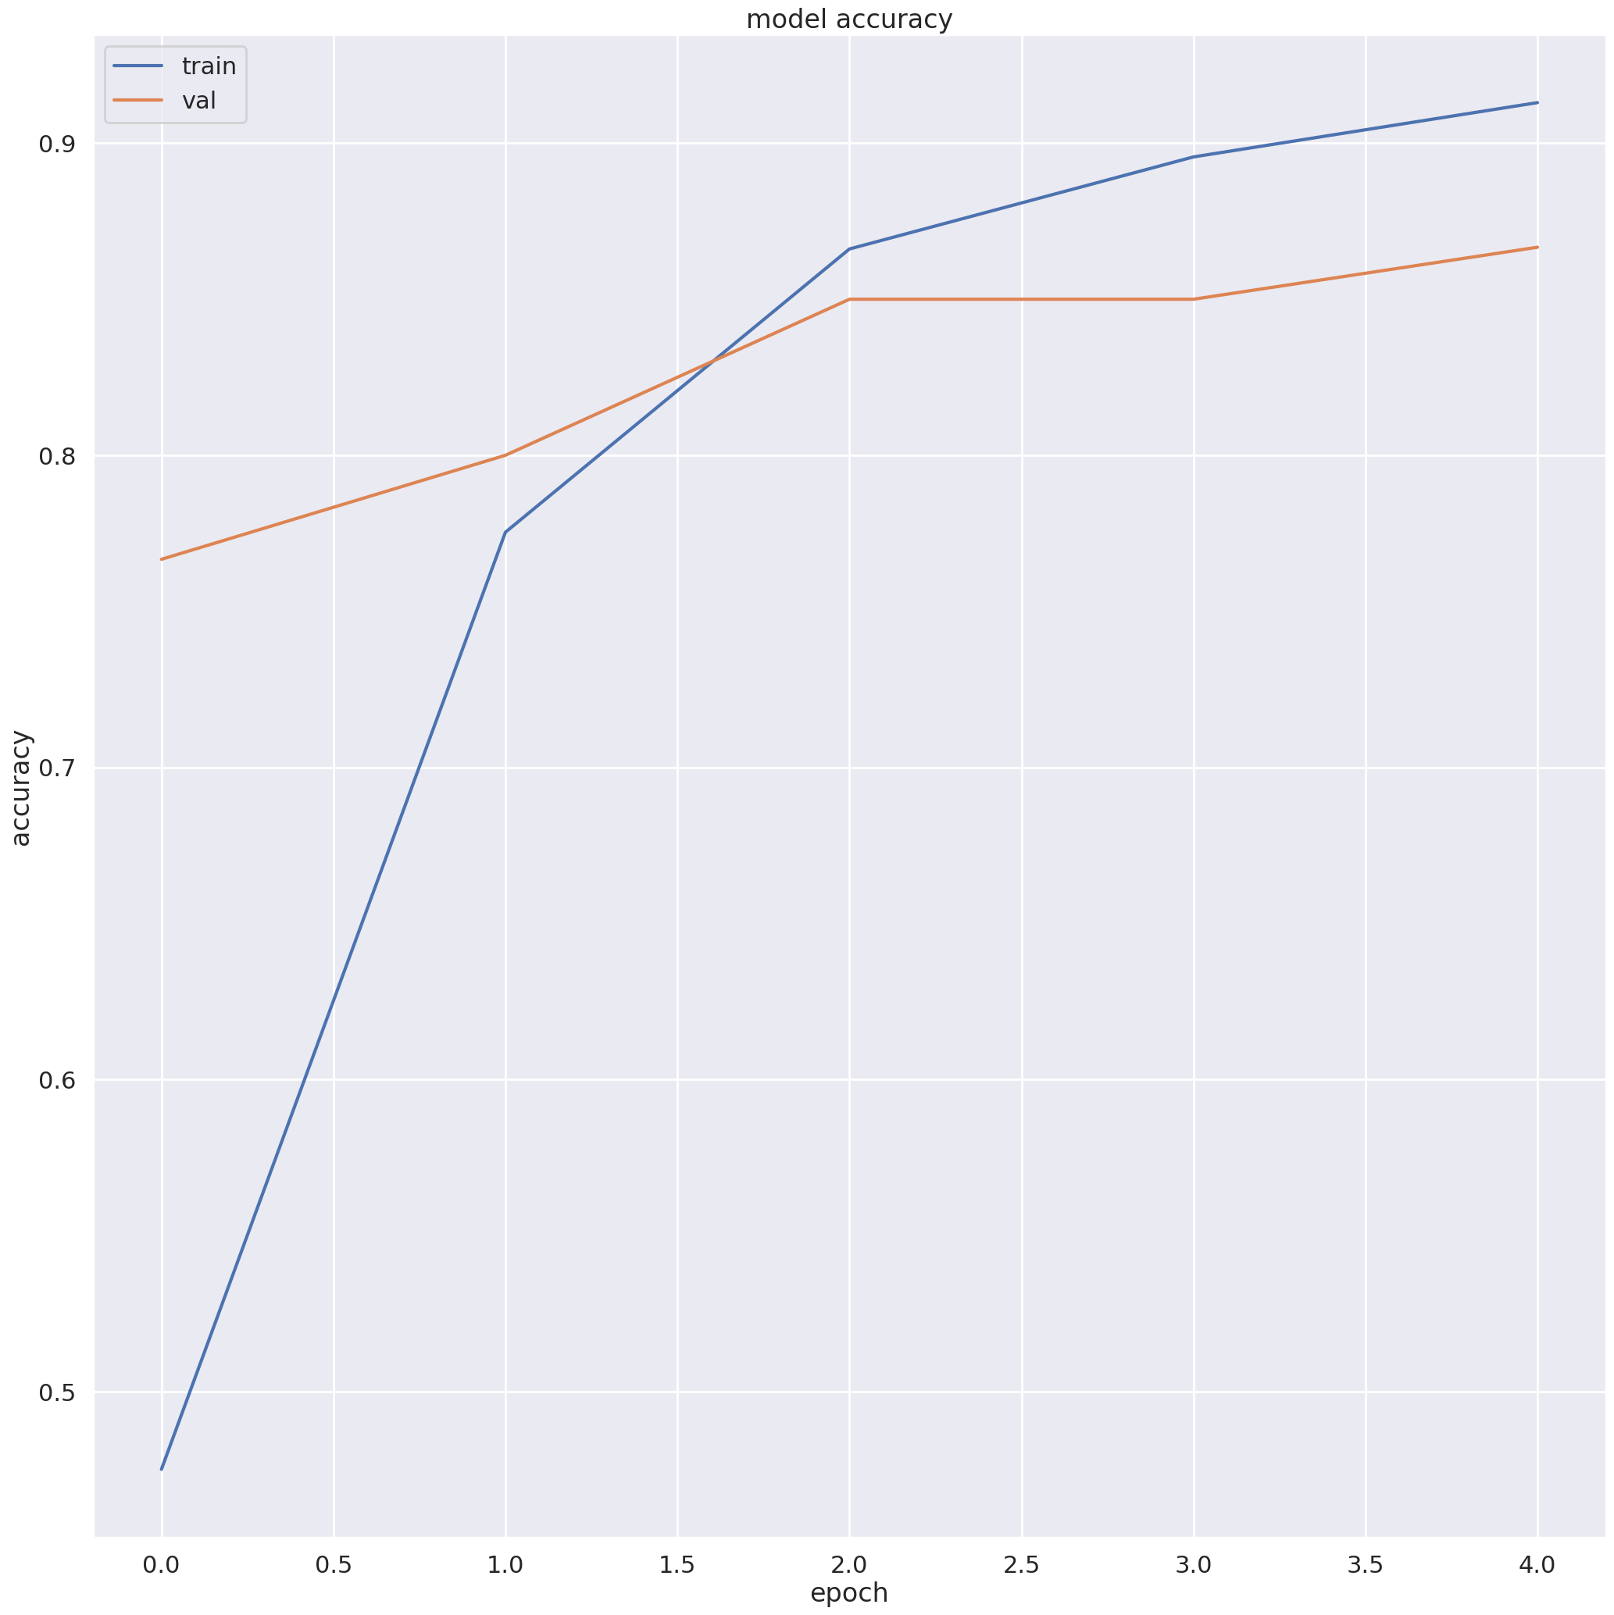
Implementation and Results – Iteration 2
Iteration : Results + Validation against the use cases and test cases
Iteration Results: The graph shows how the model’s accuracy improves with each training epoch.
Training accuracy (blue line) improves rapidly.
Validation accuracy (orange line) also improves, but at a slower pace.
Validation Against Use Cases and Test Cases:
After each iteration (epoch), we check the model's performance against real-world use cases (what the model should do in practical situations).
We also evaluate it with test cases (specific examples that weren’t part of the training data) to ensure it generalizes well and doesn’t just memorize the training data.
Figure-6: Training and validation accuracy progression over epochs

Slide 19
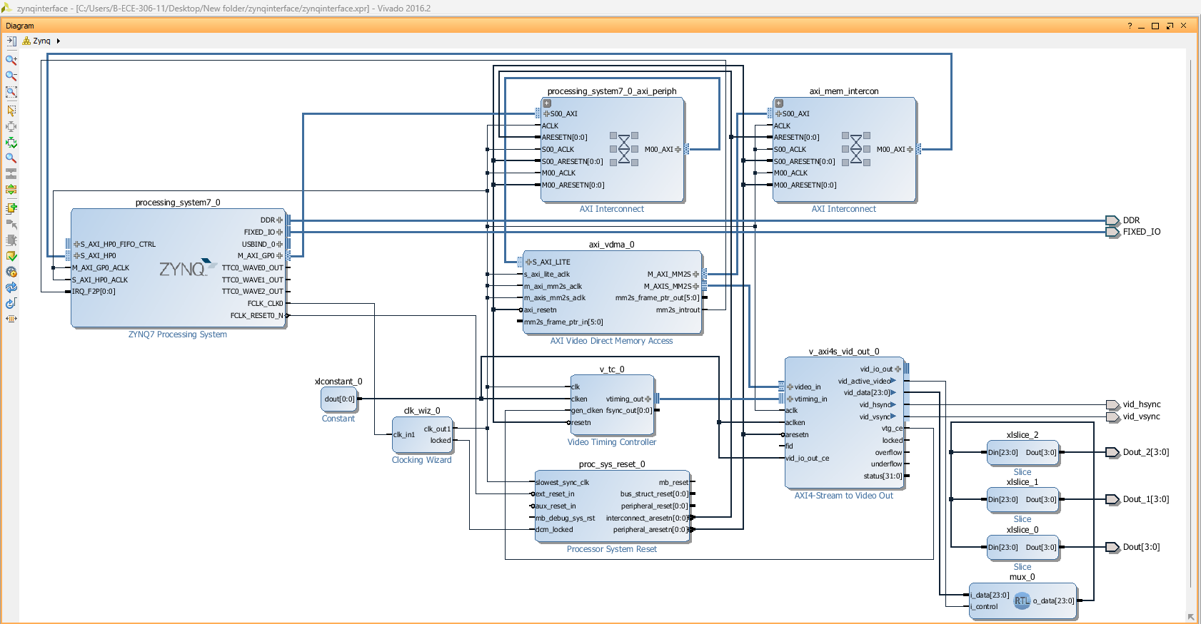
This is a block diagram representing a system using the ZYNQ-7000 Processing System and several AXI interfaces, along with video-related IP cores for a video processing design.
The diagram illustrates how different components, such as the AXI Video Direct Memory Access (VDMA), Video Timing Controller (VTC), and AXI4-Stream to Video Out, are connected within the system.
Validation:
Ensure the AXI interfaces properly transfer data between the processing system and other IP blocks, such as the VDMA for video data handling
Verify that the timing signals (like clk and rst) are correctly synchronized, especially in blocks like the VTC and video output stream components.
Test Cases:
AXI interface communication between IP cores and the processing system.
Handling of edge cases such as data overflow, underflow, or synchronization errors.
Fig-7: ZYNQ-7000 Processing System with AXI Interfaces and Video Data Path Configuration

Slide 20
Real-Time Automated Plant Disease Classification–Progress Summary(Review 2)
Integrated the system with ZYNQ-7000, ensuring proper AXI communication and video processing.
Work Completed:
Collected and categorized plant leaf images into Healthy, Powdery, and Rust classes.
Developed and trained a CNN model using Keras and TensorFlow on Google Colab.
Implemented data augmentation to improve accuracy and generalization.
Validated model performance against real-world use cases and test cases.
Integrated the system with ZYNQ-7000, ensuring proper AXI communication and video processing.
Results:
Training accuracy improved with each iteration, showing effective learning.
Validation accuracy demonstrated good generalization on unseen data.
Model successfully classified plant diseases in real-time with reliable predictions.
ZYNQ-7000 implementation ensured smooth data transfer and processing.
Conclusion:
The system provides an automated, scalable, and efficient solution for plant disease detection.
Early detection enables timely action, reducing crop loss and improving yield.
The combination of deep learning and hardware integration ensures practical real-world application.
This approach enhances agricultural management by enabling faster decision-making.

Slide 21
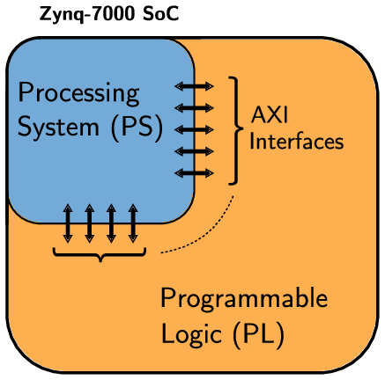
Review 3: Image Processing with Zynq: Edge Detection
Introduction
This project focuses on real-time edge detection using a Zynq-based system, enabling the processing and display of both original and edge-detected images on a monitor. It integrates custom image processing IP, video interfacing, and DMA-based data transfer to achieve efficient performance. The implementation involves hardware-software co-design, ensuring seamless interaction between the processing system and programmable logic. Key aspects include configuring video output, handling data transfer, and optimizing processing speed for real-time execution.
Key Components
Zynq IP Repository – Pre-designed Sobel edge detection IP is used for real-time image processing.
SDK – Develops software to control hardware for image processing and display.
AXI DMA – Transfers data quickly between memory and processing units.
AXI VDMA – Buffers video frames and manages smooth data flow.
Video Timing Controller (VTC) – Synchronizes video signals for proper display.
HDMI Output – Shows original and processed images on a monitor.
Fig-8: Block Diagram of Zynq 7000 SOC

Slide 22
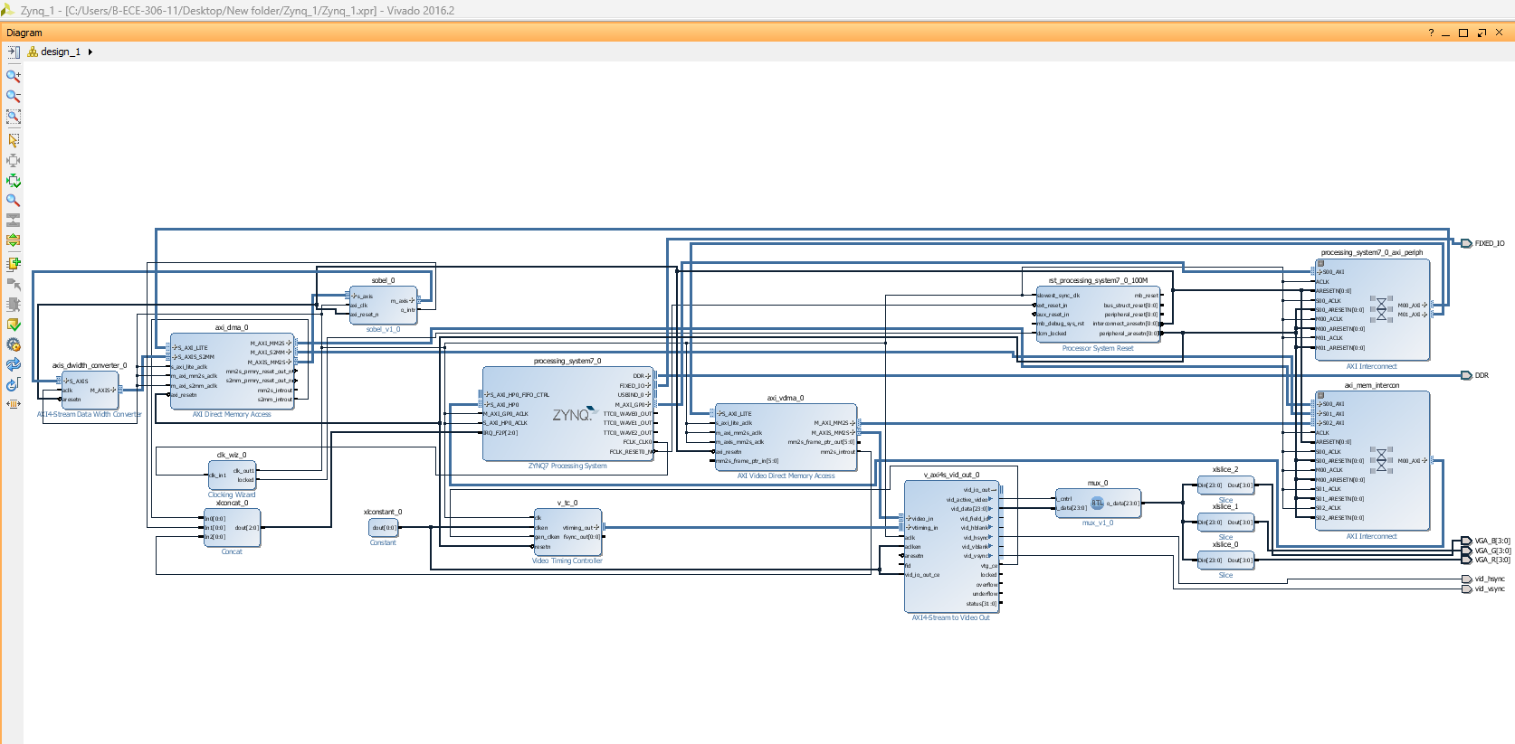
Implementation Workflow in Vivado
Creating a New Vivado Project
Open Vivado and create a new project.
Select Zynq-7000 SoC as the target device.
Choose the RTL Project type and enable the IP Catalog.
Adding Zynq Processing System (PS)
Insert the Zynq Processing System (PS) block into the block design.
Run Block Automation to configure basic settings.
Enable required interfaces like GP, HP, and AXI Interconnects for
communication.
Integrating the Custom Sobel Edge Detection IP
Add the custom Sobel edge detection IP from the IP catalog.
Connect the IP to the AXI interface for data transfer.
Modify the address mapping for proper communication with the PS.
Configuring AXI DMA and VDMA for Image Processing
Insert AXI DMA for high-speed data transfer between PS and PL.
Configure AXI VDMA for handling video frame buffering.
Connect the video stream input and output to ensure proper data flow.
Fig-9: Vivado Block Design – Integration of Processing System, Custom IP, and AXI Peripherals

Slide 23
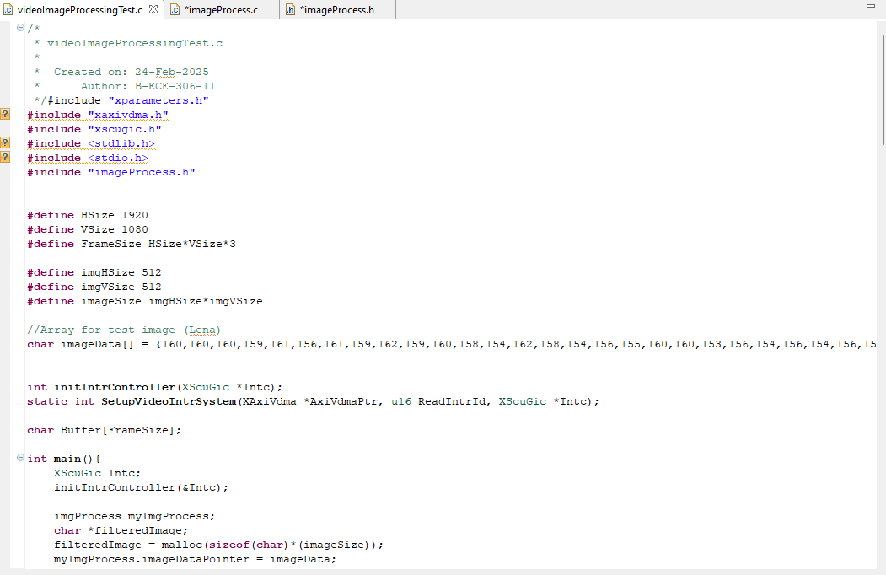
Configuring Video Output and Clock Settings
Add Video Timing Controller (VTC) for generating synchronization signals.
Include AXI4-Stream to Video Out IP for HDMI display.
Use a Clock Wizard to generate the required 148.5 MHz clock for 1080p resolution.
ZedBoard Hardware Connections
HDMI Output: Connect the ZedBoard’s HDMI TX port to a monitor.
Power Supply: Ensure the board is powered using a 12V adapter.
USB-UART: Connect the USB cable to the PC for serial communication.
Generating Bitstream and Exporting to SDK
Validate the design and run synthesis, implementation, and bitstream generation.
Export the hardware with the xsa file for software development in SDK.
Developing Software in SDK
Open SDK and create an application project.
Import the hardware description (xsa file) and include the required drivers.
Write a C program to configure the Sobel edge detection IP and manage video
output.
Running and Testing the System on ZedBoard
Load the bitstream file onto the ZedBoard.
Run the software application from SDK.
Verify the HDMI output by toggling between the original and processed image.
Observe real-time edge detection results displayed on the monitor.
Fig-10: Software Implementation for Image Processing on Zynq-7000 SoC

Slide 24
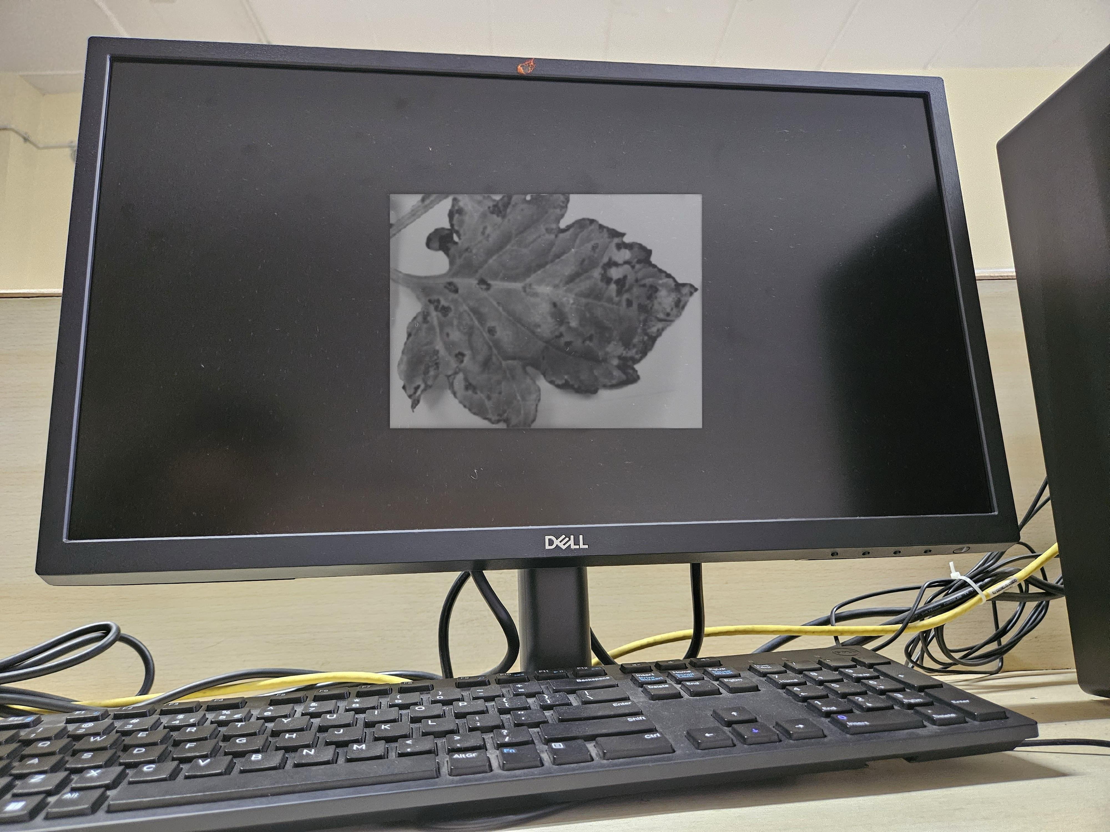
Implementation and Results – Iteration 3
Iteration : Results + Validation against the use cases and test cases
Use Case Validation:
The system successfully converts the input image to grayscale.
Disease spots are clearly visible, aiding in classification.
The Zynq-7000 SoC processes and displays the image in real-time.
Test Case Validation:
Image preprocessing (grayscale conversion) works as expected.
The system accurately captures and displays diseased regions.
The hardware correctly outputs the processed image to the monitor.
Fig-11: Grayscale Image Processing for Plant Disease Detection
The Zynq-7000 SoC processes the image, highlighting disease-affected regions, crucial for real-time automated plant disease detection.

Slide 25
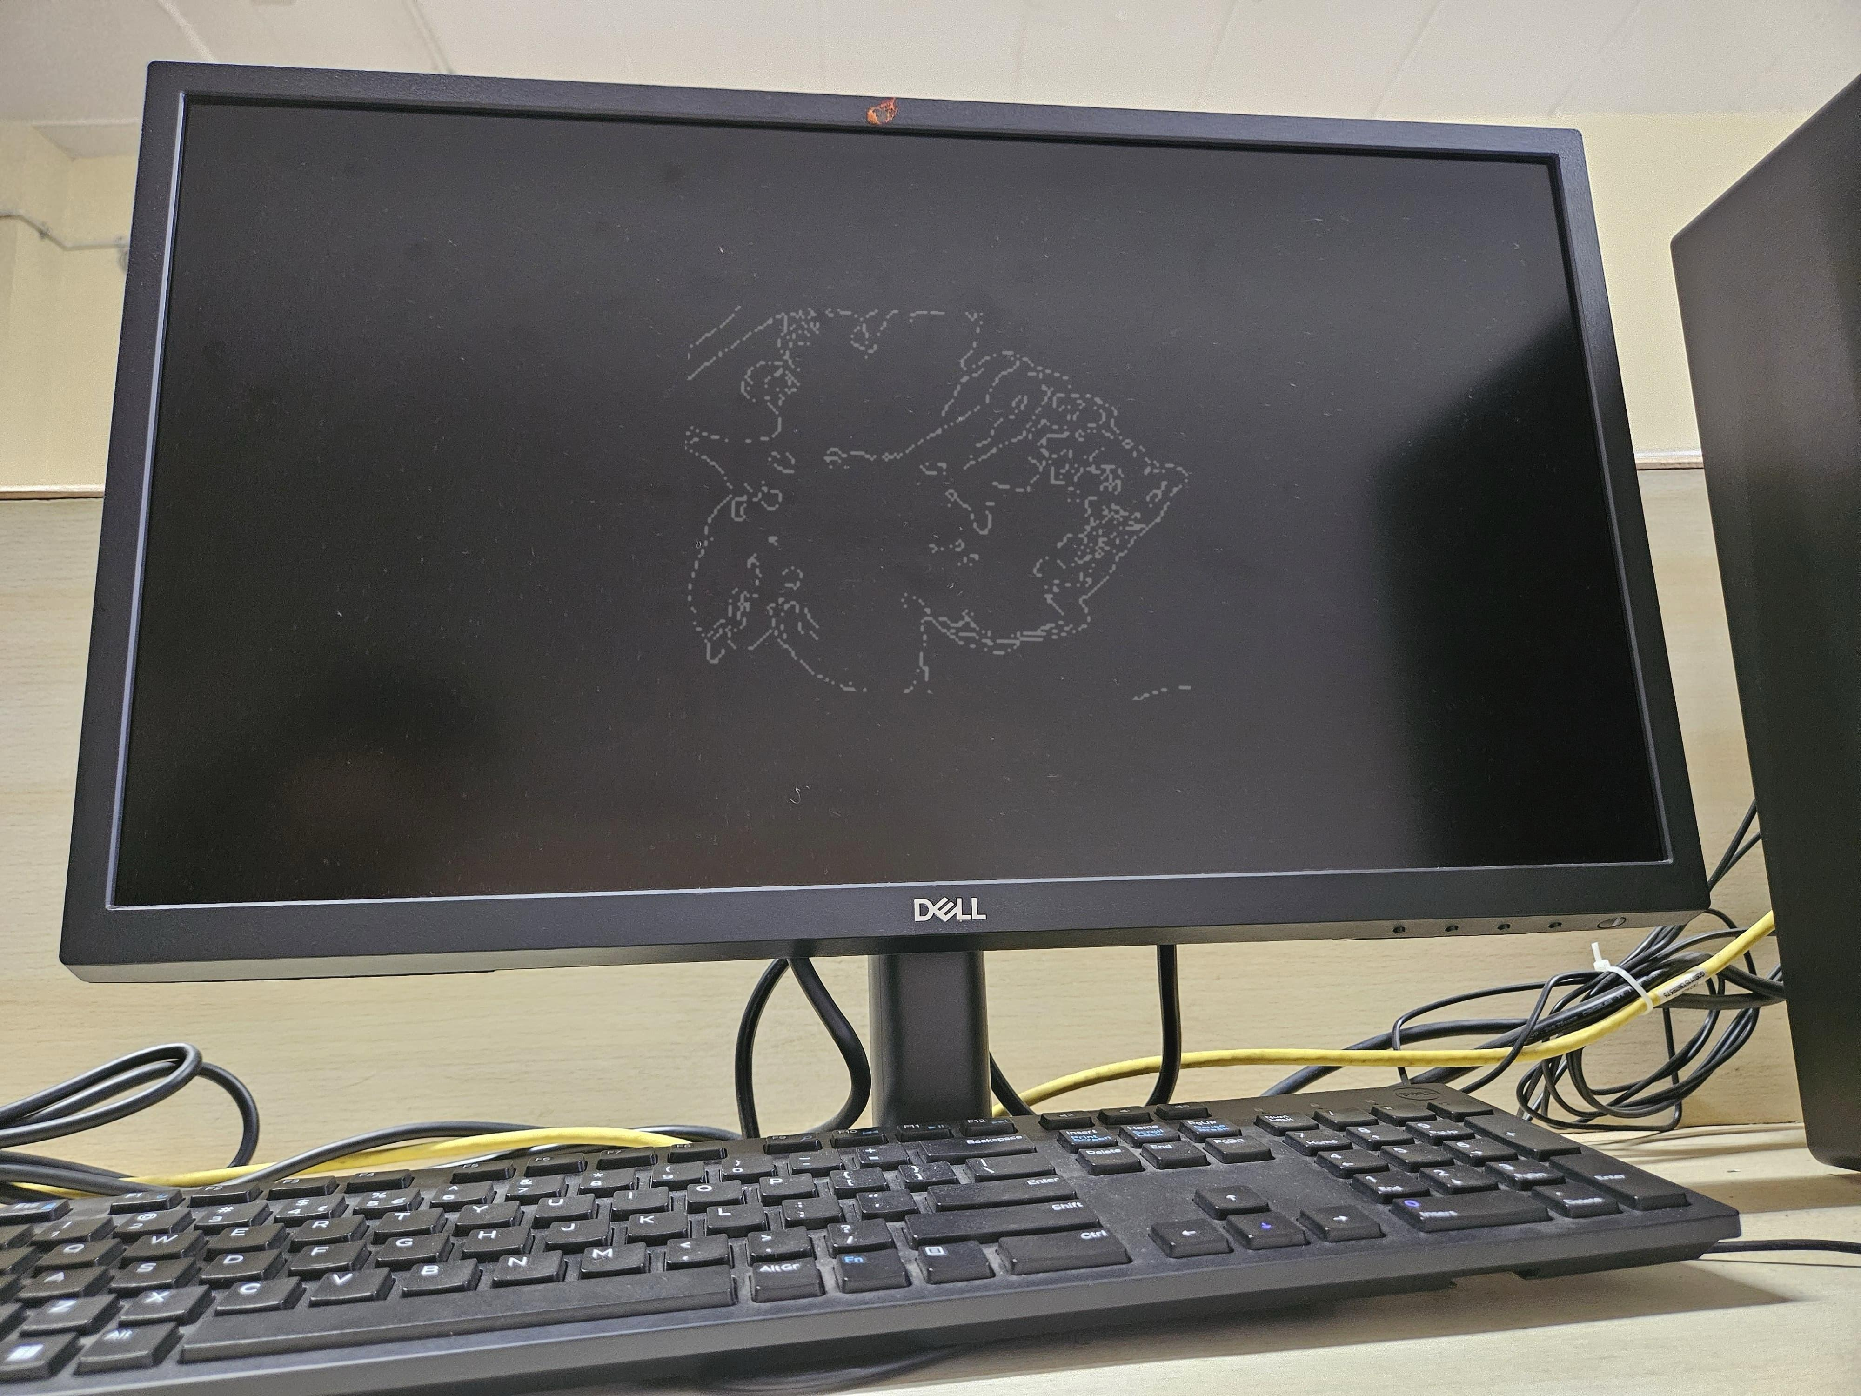
Use Case Validation:
Real-time processing is successful.
The edge detection algorithm performs well.
Hardware acceleration via Zynq-7000 SoC is validated.
Test Case Validation:
The system correctly detects edges.
Low-latency processing is achieved.
Output is displayed successfully via HDMI/VGA.
Fig-12: Edge Detection Output on Zynq-7000 SoC
The figure illustrates the real-time edge detection results of a diseased leaf, processed by the Zynq-7000 SoC. The image displayed on the monitor represents the outcome of an edge detection algorithm, which identifies boundaries and contours of the leaf, particularly emphasizing the disease-affected regions.

Slide 26
Image Processing with Zynq –Progress Summary (Review 3)
Work Completed:
Processed plant leaf images for edge detection.
Applied Canny and Sobel edge detection.
Used Zynq-7000 SoC for hardware acceleration.
Set up AXI communication for smooth data transfer.
Tested and validated results through simulation and real-time processing.
Results:
Successfully detected edges of diseased areas.
Achieved real-time processing with low delay.
Ensured stable performance and accurate detection.
Smooth integration with Zynq-7000 SoC.
Conclusion:
The system efficiently detects plant disease patterns using edge detection. Hardware acceleration makes it fast and effective. Next steps focus on improving accuracy and integrating disease classification.

Slide 27
Contribution
Team Progress and Movement
Set up and tested FPGA and Zynq-7000 integration.
Developed VGA controller and real-time plant disease detection system.
Improved accuracy, stability, and performance through testing.
Successfully integrated software and hardware for smooth processing.
Ensured practical application with real-world validation.
Individual Contribution
Key contributions: Sarai Sai Lohitha
Set up and configured the Zynq-7000 SoC environment.
Developed and tested the VGA controller for display output.
Key contributions: Ramireddy Indumathi
Implemented real-time image processing on the Zynq-7000 SoC.
Developed and optimized edge detection algorithms for plant disease identification.
Key contributions: S. Sameera Tasneem
Ensured smooth AXI communication between processing units.
Validated and tested VGA output with real-time edge detection results.

Slide 28
Conclusion & Future Work
Summary and Conclusion
Developed a plant disease detection system using image processing techniques like Otsu’s thresholding, Canny, and Sobel edge detection.
Implemented segmentation in MATLAB to enhance accuracy and efficiency.
Initiated integration with the ZYNQ-7000 SoC using Xilinx tools for real-time processing.
Established a foundation for edge AI-based implementation.
Trained an Edge AI model in Google Colab to classify plant diseases based on extracted features.
Successfully processed edge detection results in real-time, ensuring smooth data transfer and processing.
We conclude that a comparative study of edge detection techniques, including Otsu’s thresholding, Canny, and Sobel, highlights their effectiveness in segmenting diseased plant areas. The integration of these methods with the ZYNQ-7000 SoC ensures real-time processing, enabling early disease detection and improving precision agriculture.
Future Work
Extend the implementation to classify plant diseases directly on the ZYNQ-7000 SoC, integrating both detection and classification into a single embedded system.
Develop a user-friendly website to display real-time disease detection and classification results.
Integrate trained AI models into the ZYNQ-7000 SoC for on-device inference, eliminating the need for cloud-based processing.

Slide 29
THANK YOU
Have a Great Day !

